Slide 1

PREDICTION OF INTERNATIONAL MATCH RESULTS
DATA MINING AND MACHINE LEARNING
MAOR AZULAY ELAD YOSEF

Slide 2

Our research
Research quesion: Can we predict the results of international matches?

Slide 3
Data sources Data sources
http://www.rsssf.com/intland.html
https://www.myfootballfacts.com/fifa-world-cup/fifa_world_cup_by_year/

Slide 4
Competitions we want to explore
FIFA world cup
UEFA Euro
COPA America
Africa Cup of Cation
AFC Asian Cup
And more (All competitions)

Slide 5
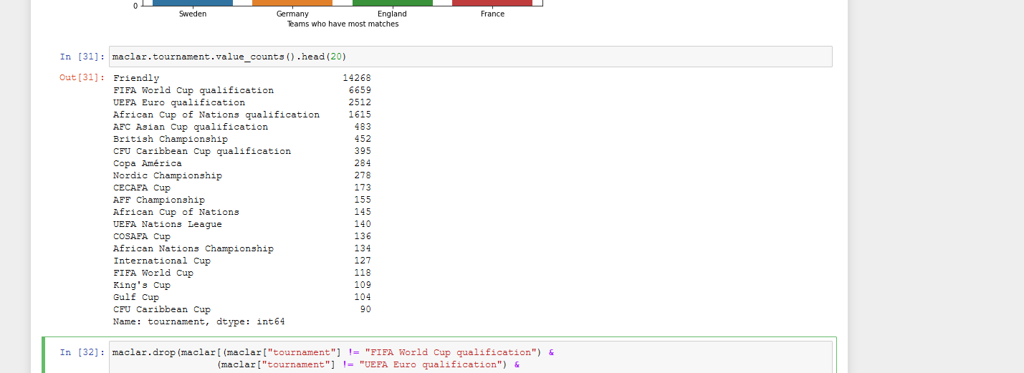
Competitions we want to explore
We did Analysis of the competitions in our dataset:

Slide 6
Exploring the Data
When we look at the dataset we realize:
we got 41540 rows
we have different type of variables in our dataset like object, bool, int etc.
When we try to apply Machine learning algorithms to our final dataset we will change all this variable type to integer type because these algorihms good at math.

Slide 7
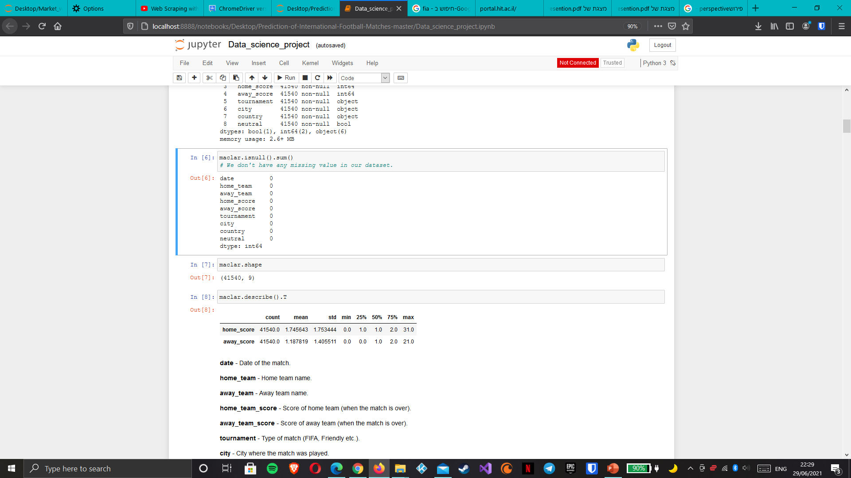
Exploring the Data
We don't have any missing value in our dataset

Slide 8
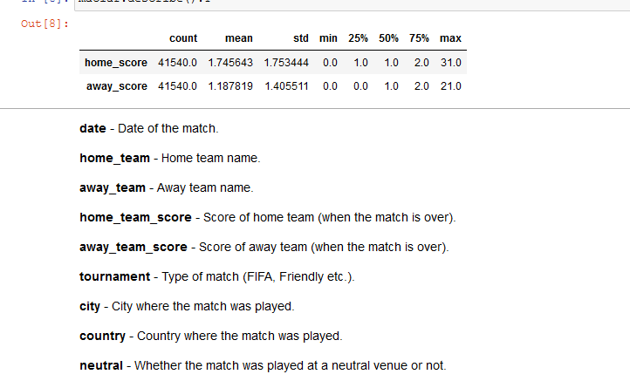
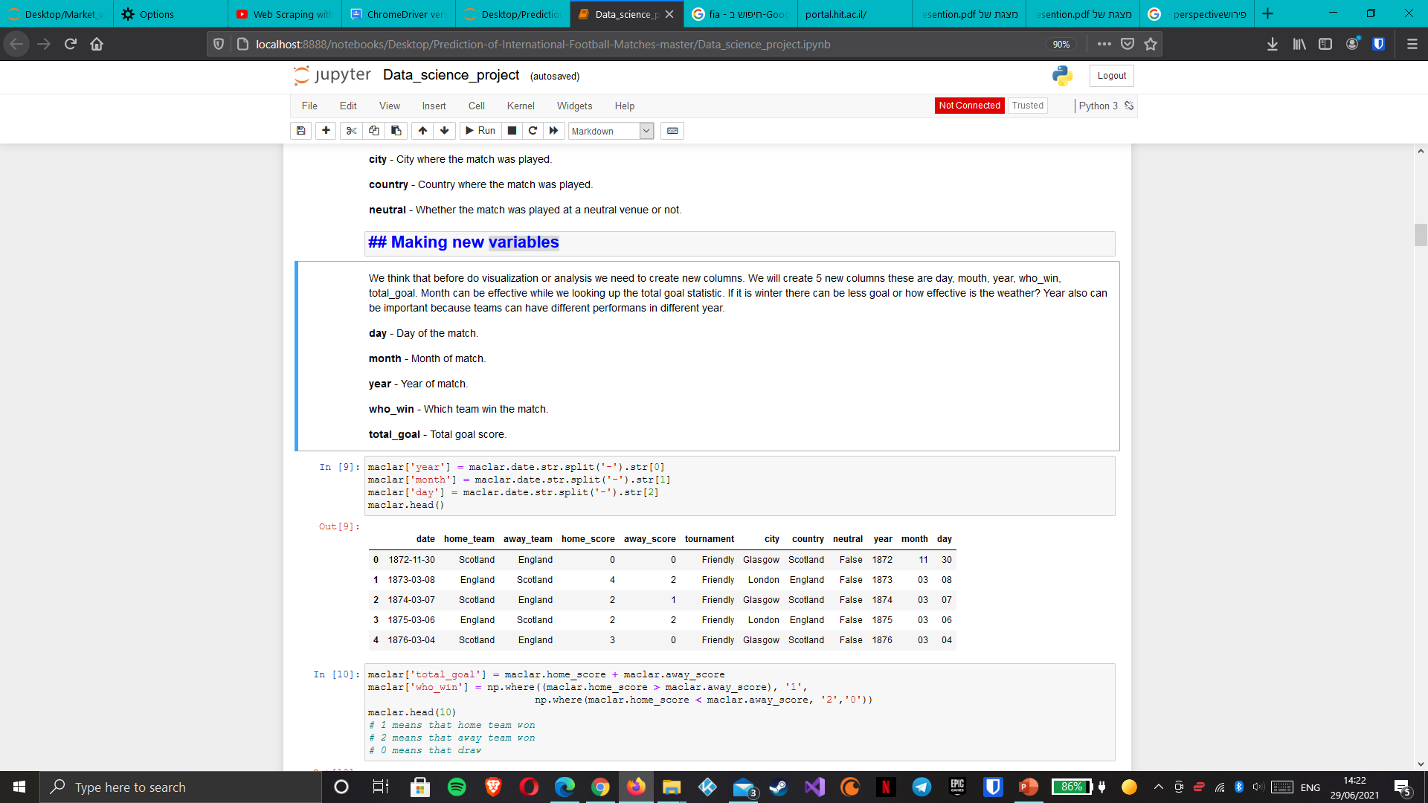
The Variables

Slide 9
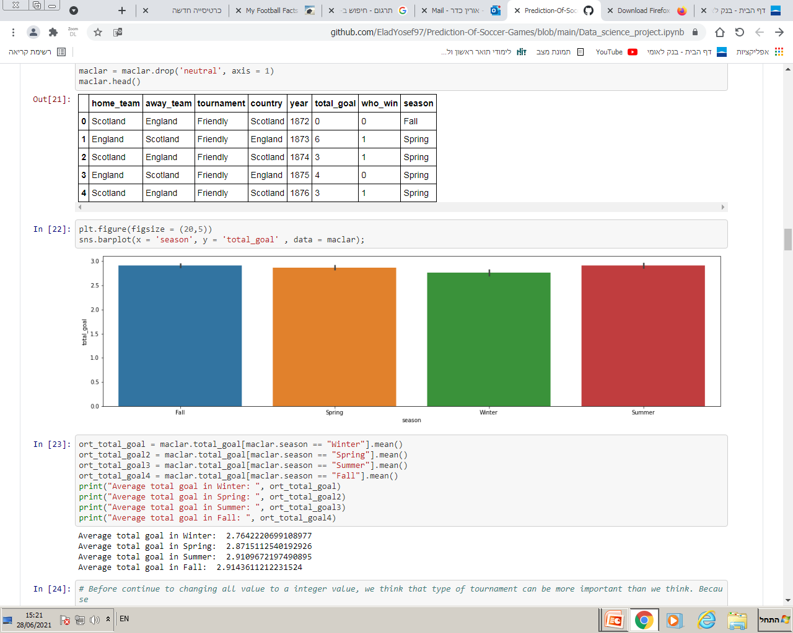
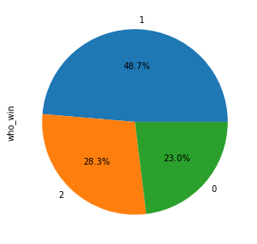
visualizing the Data
Average goals in each Season of the year
Percentage of wins in home/away perspective

Slide 10
Analysis and Visualization
When we look at the dataset We realize we got over 300 teams and over 100 tournament.
Looks like being a home team is a huge advantage but it can be even more advantage than we see
1 =home team wins
2=away team wins
0=draw

Slide 11
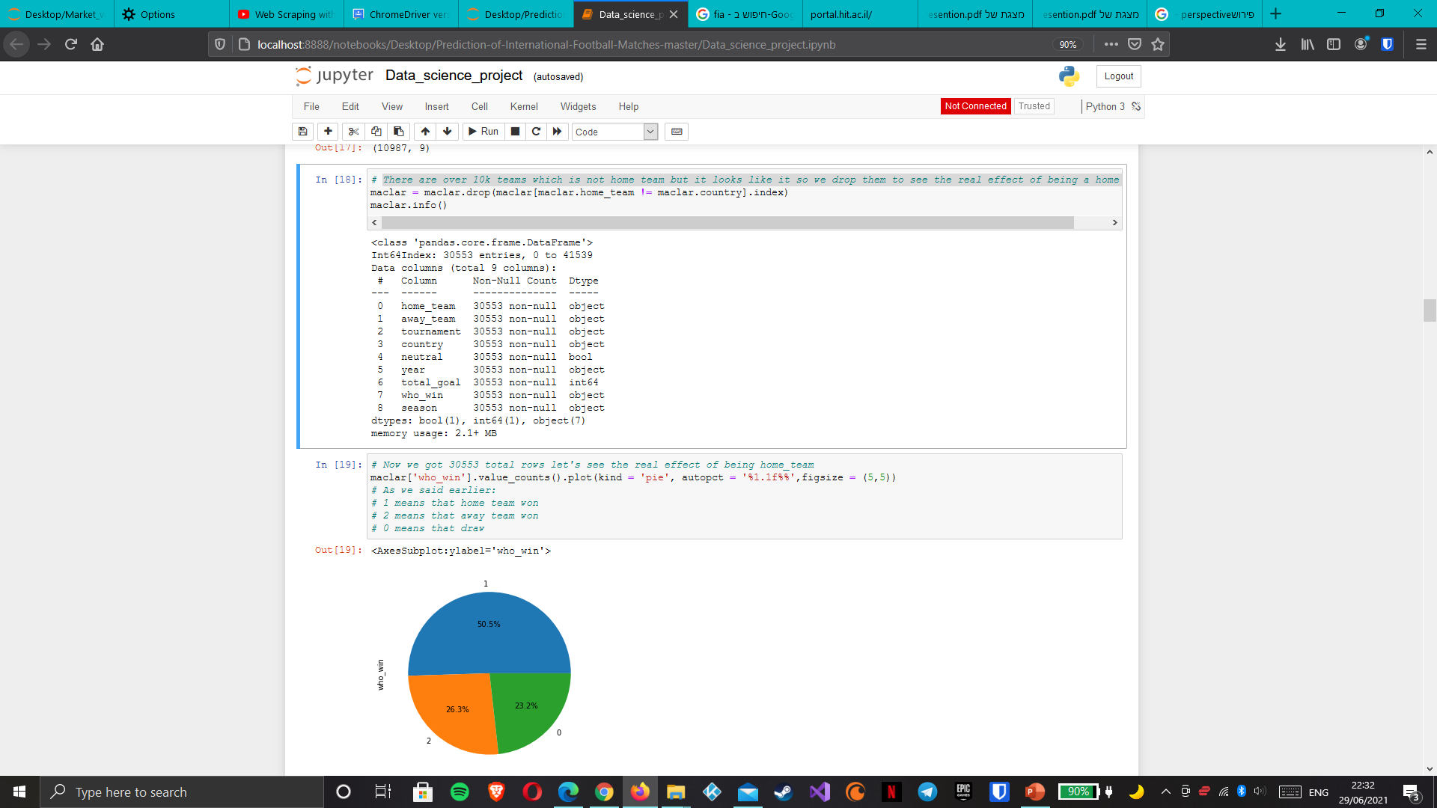
Analysis and Visualization
We know that being a home team means that match is playing in your country but there are some matches in our dataset which looks like a team a home team but there are not.
There are over 10k teams which is not home team but it looks like it so we drop them to see the real effect of being a home team.

Slide 12
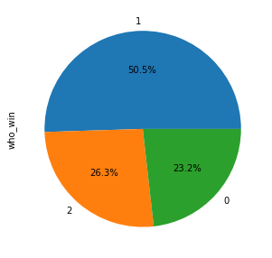
Analysis and Visualization
Now we got 30553 total rows let's see the real effect of being home team
Being a home team is a huge advantage so when we realize these we figure out country column is very important because it is relate to home team

Slide 13
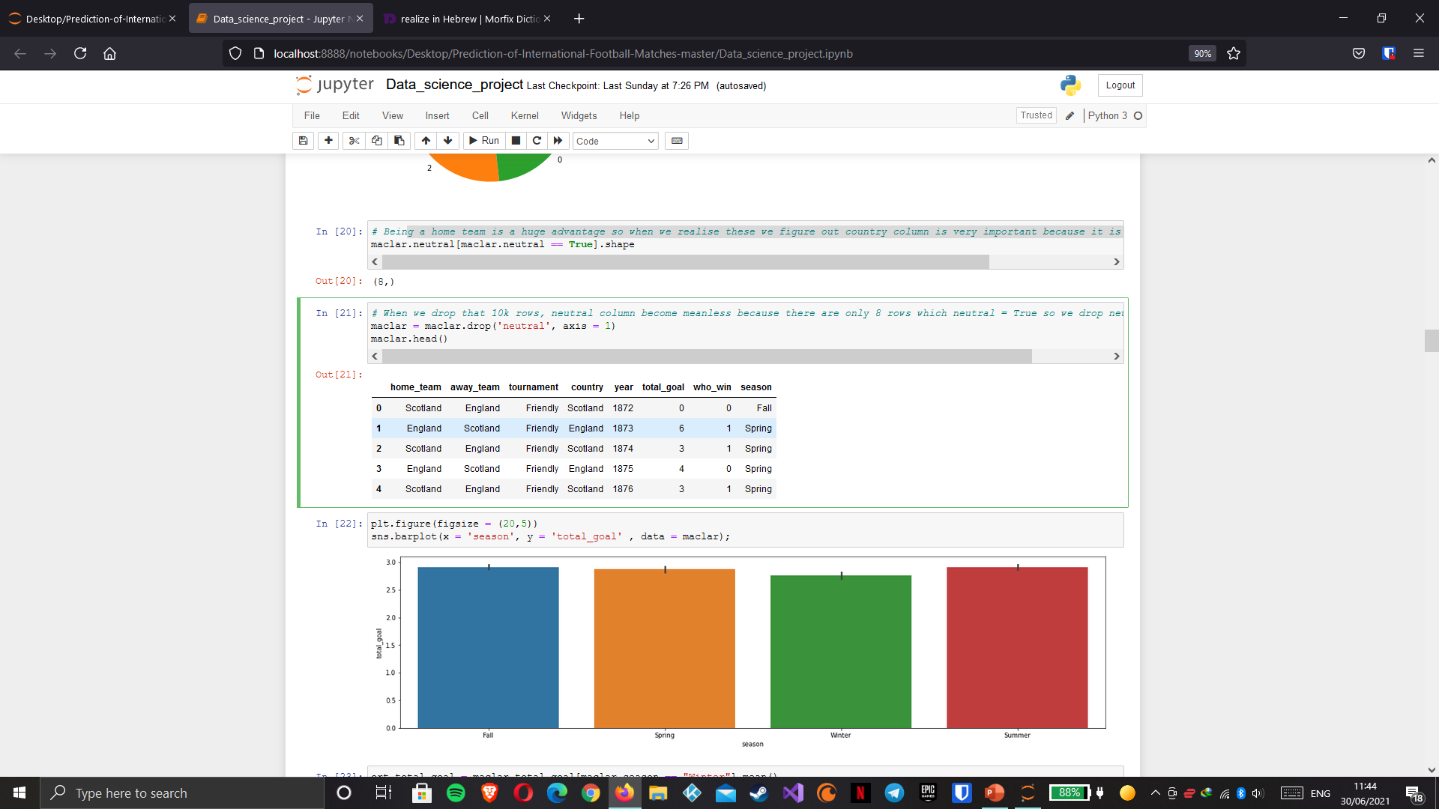
Analysis and Visualization
When we drop that 10k rows, neutral column become meanless because there are only 8 rows which neutral = True so we drop neutral column

Slide 14
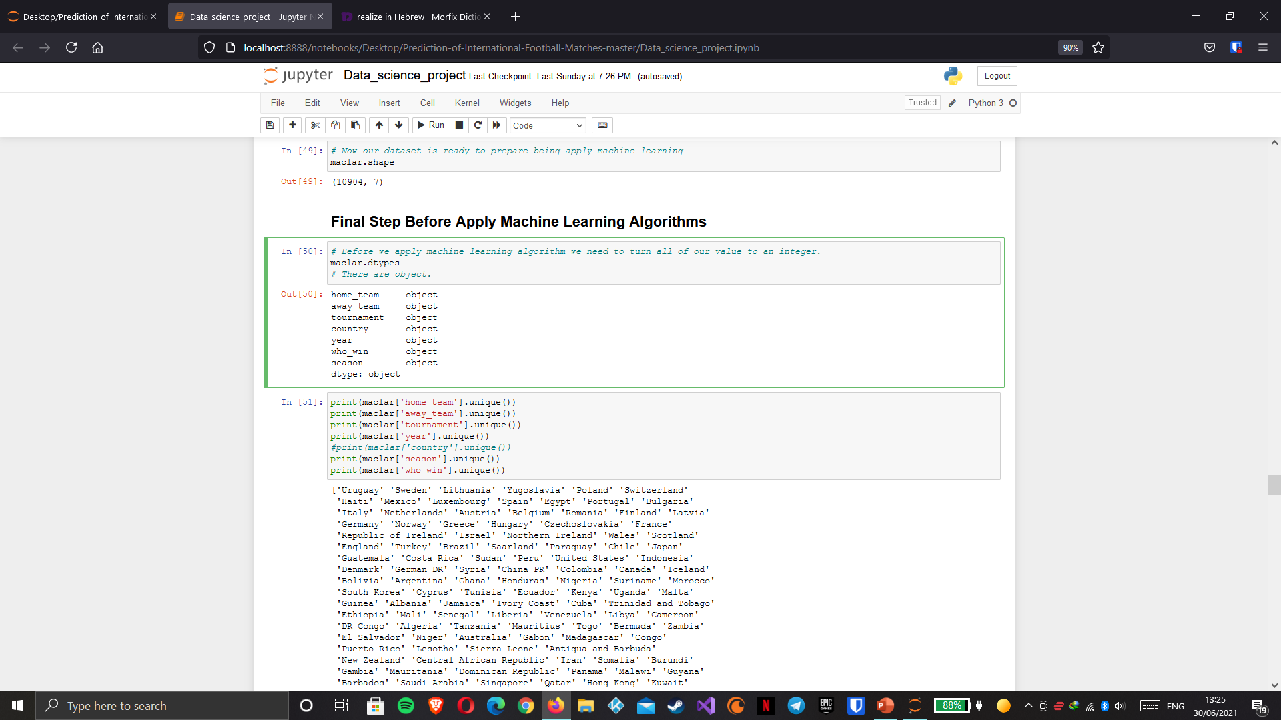
Machine Learning
Before we implement machine learning algorithm we need to turn all of our value to an integer.
Objects :

Slide 15
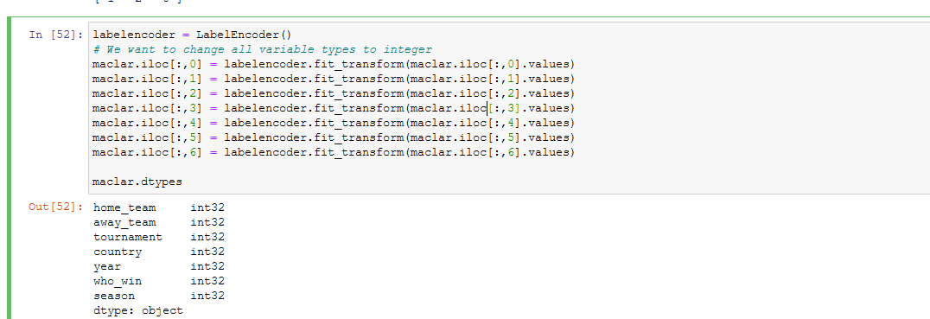
Machine Learning
change all variable types to integer
We split our dataset into a test and training datasets: 20 percent of our dataset is for testing 80 percent of our dataset is for training.

Slide 16
Machine Learning
Accuracy: 54.19%
Accuracy: 54.19%
Accuracy: 72.00%
Because of our problem is classification problem we will apply classification machine learning algorithms:
1st Decision Tree: ACC 48.35%
2nd XGB Classifier:ACC 54.57%
3rd KNeighbors Classifier:ACC 40.84%
4th LightGBM: ACC 53.37%

Slide 17
Conclusions
You can see in our dataset, we did a lot of cleaning and modifying process. When we did these cleaning process our dataset rows decrease to 10k but it become much more consistent. Does it actually help us to improve our accuracy? Or having much more but inconsistent data is a better option? Notice that we got over 40k rows in this dataset because we didn't do any cleaning process.
Best option is XGB Classifier and we think that we did our best. Because there are several different variables can effect the result of a football match.
For example players, coach style (offensive, defensive etc.), motivation etc.
At the end we have a model that can able to predict the result of a football match
with a %72 accuracy score.
We understand that having a large data is important factor but having a consistent data is much more important

